Slide 1


Other Web Service and Application Development Platforms
Distributed Computing Using Remotable Objects
in C#
in Java
AJAX Programming
Java-Based Web Service and Application Development

Slide 2
SOC Software Development Environments
SOC Software Development Environment | Platform- independent Web service | Platform- dependent service | Distributed transactions | WS-* specification | Primary language
ASMX (ASP .Net) | X |  |  |  | C# / VB
Remoting |  | X |  |  | C# / Java
Services: BizTalk |  |  | X |  | XLang / BPEL
WSE: WS Enhancements | X |  |  | X | C# / VB
WCF | X | X | X | X | C# / VB
AJAX | X |  |  |  | Java Script
Eclipse / Axis2 / Tomcat | X | X | X | X | Java
NetBeans | X | X | X | X | Java
JEE: Java Edition | X | X | X | X | Java
JDeveloper / Oracle SOA Suite |  |  | X | X | BPEL
ActiveBPEL / Tomcat |  |  | X | X | BPEL
WebSphere |  |  | X | X | BPEL / Java

Slide 3
Remotable and Nonremotable Objects
Nonremotable objects cannot leave their application domain;
They cannot be copied (migrated), or represented in another application domain through a proxy;
They are always accessed directly from their application domain;
They are used in traditional object-oriented computing
Most base classes in the .NET Framework class library are nonremotable.

Slide 4
Remotable Objects (Distributable Objects)
Remotable objects can be accessed outside their application domain or context using a proxy;
They can be copied, and these copies can be passed outside their application domain or context;
Some remotable objects are passed by reference and some are passed by value (pass the object itself);
There are two main kinds of remotable objects in .Net:
Marshal-by-value objects, which are copied and passed from the application domain (migration);
Marshal-by-reference objects, for which a proxy is created and used by the client to access the object remotely (model of Web service).

Slide 5
Distributed Computing Using Remotable Objects
Distributed Object System
Remotable Object
Message-based Communication
Pass-by-Value: Object Integration
ORB Software Bus
Pass-by-Reference: Proxy
Remotable Object
Remotable Object
Remotable Object
Remotable Object
. . .
. . .

Slide 6
.Net Remotable Object
Client
application domain
Sever
application domain
Client
Object copied
from server
Marshal-by-
value object
Channel
Proxy
Channel
Marshal-by-
Reference object

Slide 7
A Remotable Class on Server (C#)
// Start this service on a server, e.g., localhost:1234
using System;
public class SvrClock : MarshalByRefObject
{
public string GetCurrentTime ()
{
// Perform service required
return DateTime.Now.ToLongTimeString ();
}
}

Slide 8
A Client Accessing a Remotable Class on Server
The program need to run at admin mode.
using System;
using System.Runtime.Remoting;
using System.Runtime.Remoting.Channels;
using System.Runtime.Remoting.Channels.Tcp;
class MyApp {
static void Main () {
TcpClientChannel channel = new TcpClientChannel ();
ChannelServices.RegisterChannel (channel);
RemotingConfiguration.RegisterWellKnownClientType
(typeof (SvrClock), "tcp://localhost:1234/SvrClock");
SvrClock myClock = new SvrClock ();
Console.WriteLine (myClock.GetCurrentTime ());
}
}
Create
Register
Bind
Create proxy
Access
Does it generate a real object or a proxy?

Slide 9
What is the difference between a Marshal-by-reference object and a Web service

Slide 10
Web Services vs. Remotable Objects
In a Web service
A “Web Method” or “Operation Contract” specifies a method to be remotable
Only Marshal-by-reference is used
Marshal-by-value is not implemented, because code integration (migration) can happen in the same language environment only. It does not support the platform-independent requirement.
ASP .Net and WCF create WSDL interface, while .Net remotable (marshal-by-reference) does not.

Slide 11
Java Remote Method Invocation (RMI)
http://www.oracle.com/technetwork/java/javase/tech/index-jsp-136424.html
Java Remote Method Invocation (RMI) enables the programmers to create distributed Java applications;
Methods of remotable Java objects can be invoked from other Java virtual machines. RMI uses Marshal-by-reference.
To make a remote object accessible to other virtual machines, a program registers it with the RMI registry.
When accessing a remote object, it supplies the object's string name to the registry on the same machine as the remote object. The registry returns to the caller a reference (called stub). The program then invoke methods through the stub.

Slide 12
Java RMI Example (Remote Service)
http://docs.oracle.com/javase/jndi/tutorial/objects/storing/src/HelloImpl.java
// This class is running as a remote service.
// It implements the library Hello interface.
// The class must be running before the client can access this service;
// It will be remotely invoked by the RemoteObj example in the next page
import java.rmi.*;
import java.rmi.server.UnicastRemoteObject;
public class myHello extends UnicastRemoteObject implements Hello
{
public myHello() throws RemoteException { }
public String sayHello() throws RemoteException {
return ("Hello, the time is " + new java.util.Date());
}
}

Slide 13
Java RMI Example (Client)
http://docs.oracle.com/javase/jndi/tutorial/objects/storing/src/RemoteObj.java
class RemoteObj {
public static void main(String[] args) { // Set up environment for
Hashtable env = new Hashtable(11); // creating initial context
env.put(Context.INITIAL_CONTEXT_FACTORY, "com.sun.jndi.ldap.LdapCtxFactory");
env.put(Context.PROVIDER_URL, "ldap://localhost:389/o=JNDITutorial");
try { // Create the initial context DirContext
ctx = new InitialDirContext(env); // Create environment object
Hello h = new myHello(); // Create object to be bound
ctx.bind("cn=RemoteHello", h); // Bind to directory
Hello h2 = (Hello)ctx.lookup("cn=RemoteHello");
System.out.println(h2.sayHello()); // access remote object
ctx.close(); // Close context when done
} catch (NamingException e) { System.out.println("Operation failed: " + e); } catch (RemoteException e) { System.out.println("Operation failed: " + e); } } }
Create context & channel
Create object
Bind directory
Bind object
Access

Slide 14
AJAX Programming
Asynchronous JavaScript and XML

Slide 15
AJAX Programming
AJAX (Asynchronous JavaScript and XML) programming is supported both in Java and in C# Web programming environments;
AJAX is a technology to build dynamic web pages on the client side executed in Web browser;
Key benefit: Responsiveness: Partial data refresh
Request and data processing can be implemented at the client and server sides.
Data is read from the server or sent to the server by JavaScript requests;

Slide 16
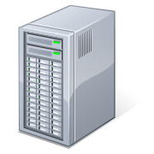
How Does a Normal Server Page Work?
Browser refresh
Page refreshed
A mouse click
Server Page
ASU Engineering Building
699 S Mill Avenue
Server generate a new HTML page
The contents of the forms will be overwritten.

Slide 17
Example of an AJAX Application
http://www.oracle.com/technetwork/java/javaee/tutorial-jsp-140089.html
A feature of AJAX is to make the user interfaces of web applications more responsive and interactive by updating only part of the page at a time.
Client Machine
Server
Browser
Web server / Web services
Server side
request processing
①
HttpRequest
②
③
Data
processing
④
⑦
JavaScript
call
Update
JavaScript
Data
request
Data
⑤
XMLHttpRequest
⑥
XML Data post back in the same page
Database
XMLHttpRequest
Callback()
Application workflow / processing

Slide 18
Sample JavaScript to Call the Server Side Service http://developer.mozilla.org/en/docs/AJAX:Getting_Started
<script type="text/javascript" language="javascript">
function makeRequest(url) {
var httpRequest;
if (window.XMLHttpRequest) { // Mozilla, Safari, ...
httpRequest = new XMLHttpRequest();
if (httpRequest.overrideMimeType) {
httpRequest.overrideMimeType('text/xml');
}
}
else if (window.ActiveXObject) { // IE
try {
httpRequest = new ActiveXObject("Msxml2.XMLHTTP");
} catch (e) {
try {
httpRequest = new ActiveXObject("Microsoft.XMLHTTP");
} catch (e) { }
}
}
Creating a request object
Creating a hosting object

Slide 19
Contd.
httpRequest.onreadystatechange = function() { alertContents(httpRequest); };
httpRequest.open('GET', url, true);
httpRequest.send(null);
}
function alertContents(httpRequest) {
if (httpRequest.readyState == 4) {
if (httpRequest.status == 200) {
alert(httpRequest.responseText);
} else alert('There was a problem with the request.');
}
}
</script>
<span
style="cursor: pointer; text-decoration:
underline"onclick="makeRequest('test.html')">
Make a request
</span>
Call a server function to reload data
Main code

Slide 20
Drawbacks of AJAX Programming
JavaScript is executed in the Web Browser
You need to program your client page in JavaScript, which could be complex;
Single page implementation: Does not support transitions between pages;
Not all browsers support AJAX and JavaScript.
Solution
AJAX run at server side as a server control
e.g., ASP .Net server side AJAX
on other server platforms

Slide 21
AJAX Programming on ASP .Net
ASP .Net AJAX (previously called Microsoft Atlas)
combines ASP .Net server controls and the traditional AJAX. For example, you can take an existing application and add additional client-side behaviors using ASP .NET AJAX;
is a part of VS 2008 or later version.
Resources and Tutorials available at: http://www.asp.net/ajax
AJAX Control Toolkit Download: http://ajaxcontroltoolkit.codeplex.com/

Slide 22
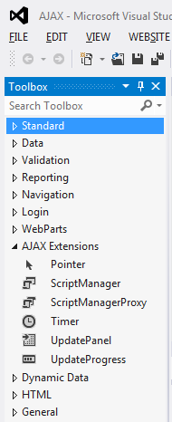
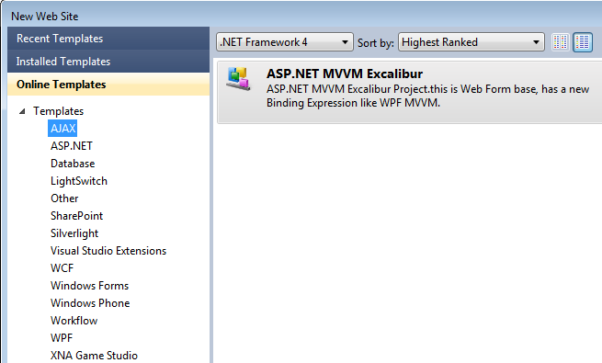
Installing AJAX Control Toolkit
In Visual Studio 2010, it is an online template, and in 2012 and 2013, it is included in the installed template.
2013
2010
Installed AJAX controls

Slide 23
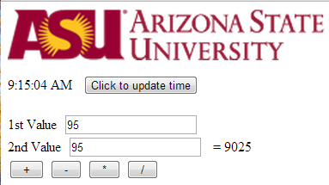
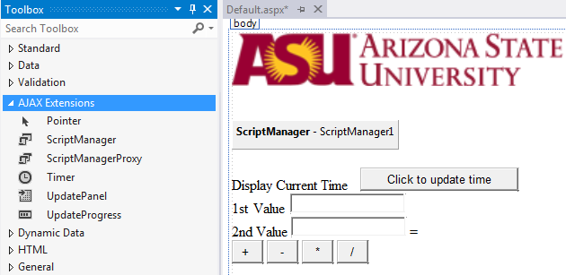
AJAX Programming under ASP .Net
Demo:
Without reloading large files such as photo
Without clear the data you have entered
Define the area in which partial data refresh is allowed
Label
Button
TryIt: http://venus.eas.asu.edu/wsrepository/AjaxIn/Default.aspx

Slide 24
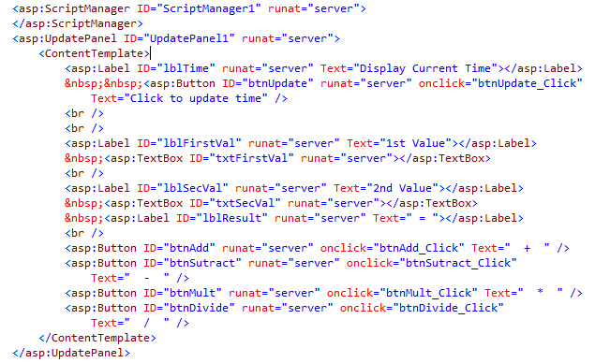
ASPX Source Code behind GUI Design
Define the area in which partial data refresh is allowed

Slide 25
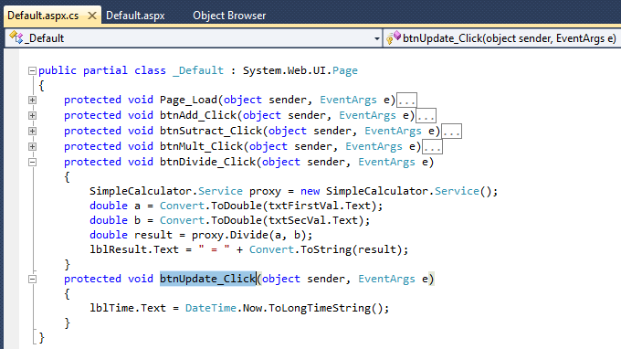
C# Code behind the Button

Slide 26
Java-Based Web Services Development Environments
Using NetBeans and Java EE
Using Axis2 Web Tools, Eclipse, and Apache Tomcat Server

Slide 27
ASP .Net versus Java-based SOC Development Environments
OO Programming Languages
C#, J#, and VB
Java
OO Development Environment
Visual Studio for OOC
Eclipse
…
NetBean
SOC Development Environment
ASP .Net / WCF for SOC
Axis2
…
Java EE
Service Hosting
.Net Development Server / IIS
Tomcat
…
Oracle SOA Suite

Slide 28
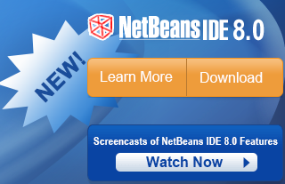
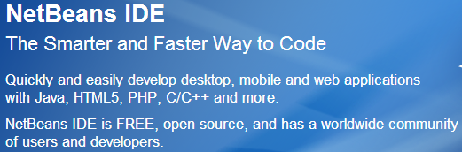
Using NetBeans
Download: https://netbeans.org/
Other Tutorials, e.g.,:
http://staff.um.edu.mt/cabe2/lectures/java/ide/netbeans_tutorial.pdf
https://netbeans.org/kb/docs/websvc/jax-ws.html

Slide 29
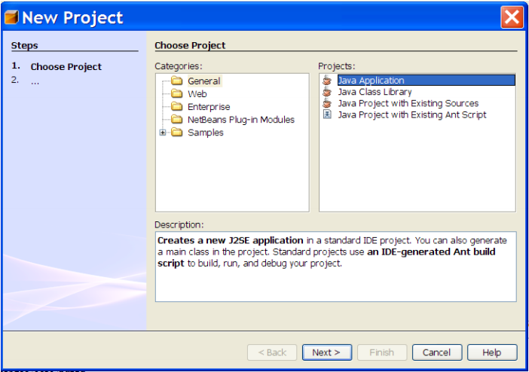
Getting Started with NetBeans: New Project

Slide 30
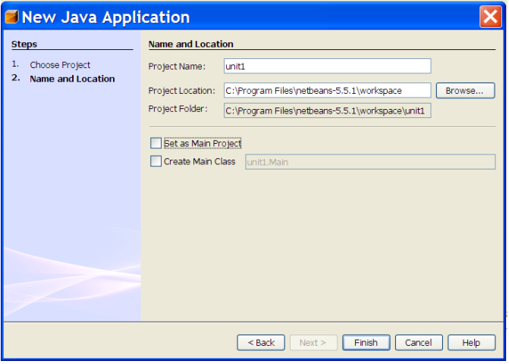
Getting Started with NetBeans: Name and Location

Slide 31
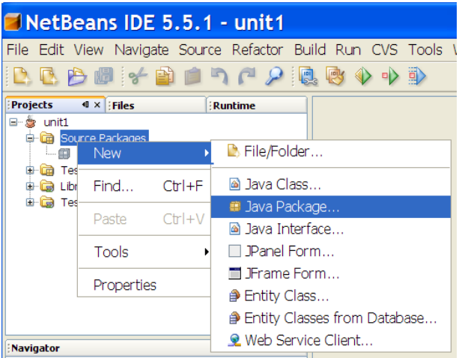
Getting Started with NetBeans: Add New Package

Slide 32
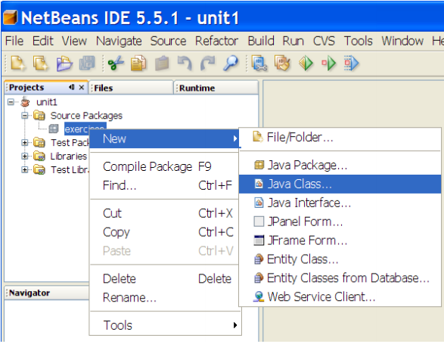
Getting Started with NetBeans: Add New Class

Slide 33
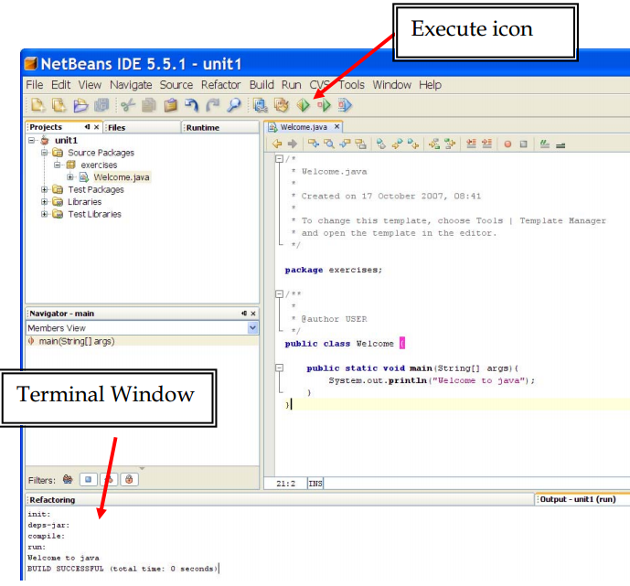
Getting Started with NetBeans: Write Code

Slide 34
Configure NetBeans for Web Services
To generate a web service client in the IDE from a web service or WSDL file you need to modify the IDE configuration file (netbeans.conf) to add the following switch to netbeans_default_options
-J-Djavax.xml.accessExternalSchema=all

Slide 35
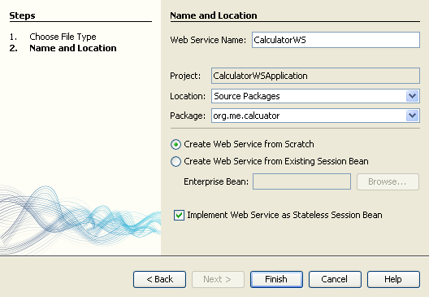
Creating Web Services Using Java EE
Start a new project or right-click the solution node and choose New → Web Service.
Name the web service CalculatorWS and type org.me.calculator in Package. Leave Create Web Service from Scratch selected.
If you are creating a Java EE project on GlassFish or WebLogic, select Implement Web Service as a Stateless Session Bean.

Slide 36
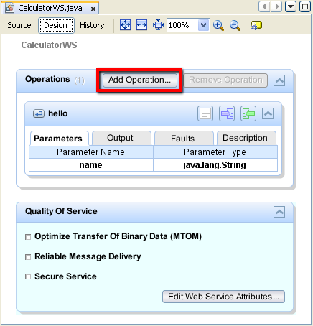
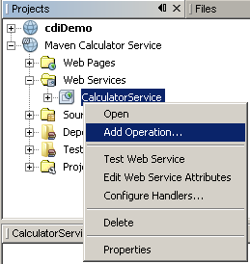
Add an Operation in a Web Service

Slide 37
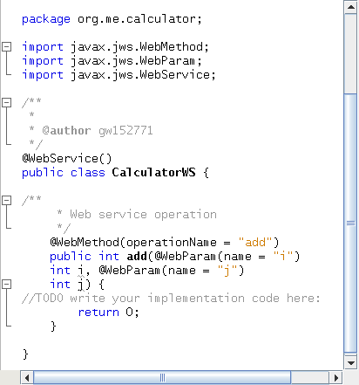
Write Code for the Operation

Slide 38
What is Axis2?
http://ws.apache.org/axis2/
Axis2 was first released in 2005
Send and receive SOAP messages
Create a Web service out of a plain Java class
Create implementation classes for both the server and client using WSDL standard
Create WSDL file for a service
Axis2
Java Object
Method calls in proxy
SOAP message generated
SOAP over HTTP
Client
Server
SOAP over HTTP
SOAP message received
Java method calls
Java Object

Slide 39
Further Features of Axis2
Send and receive SOAP messages with attachments
Create or utilize services that take advantage of the Quality of Services recommendations (chapter 6)
WS-Security,
WS-ReliableMessaging,
WS-Addressing,
WS-Coordination, and
WS-Atomic Transaction
Modular structure allowing extension for new recommendations as they emerge

Slide 40
The Predecessor of Axis2
Predecessors: Apache SOAP and Apache Axis (Axis1)
Keep the entire SOAP message in memory – DOM model of XML data processing (chapter 4)
Complex two-step deployment model involving manually copying files into the required location
Based on Remote Procedure Call (RPC) over SOAP, which requires the system to “answer” to each request (two-ways), this requirement causes problems for non-RPC style interactions, such as one-way messaging.

Slide 41
Improvements in Axis2
New SOAP Object Model
Better Support for message exchange patterns, with both synchronous and asynchronous behavior
Improved deployment model
Pluggable data binding
Improved Handlers (Filter) framework

Slide 42
The New SOAP Object Model in Axis2
Axis1: keeping the entire SOAP message in memory
SOAP message is an XML document with a tree structure;
DOM model of XML data processing;
Consume a large piece of memory.
Axis2: keeping SOAP message outside memory
Uses SAX (Simple/Streaming API for XML) model, which reads in SOAP object on demand in a stream (chapter 4), one node at time;
Cannot read the document back and forth

Slide 43
Better Support for Message Exchange
Axis2 moves to WS-based Message-Style Interaction.
Two Ways
Server
Client
Synchronous communication: Have to wait for the response. It may hold the client for a long time.
Axis1
Semi-Two Ways
Server
Client
Automatic confirmation
Asynchronous communication without blocking the client. The sever can call back
One Way
Server
Client
. . .
Another One Way

Slide 44
RPC versus WS Remote Invocation
RPC (Remote Procedure Call) is characterized by
Tightly coupled with control flow dependency
Two-way blocking call
Synchronous communication
Platform dependent, e.g., .Net to .Net, and Java to Java
Web Service Remote Invocation
Tightly and loosely coupled
Two-way blocking and one-way non-blocking calls
Synchronous and asynchronous communications
Platform independent, with WSDL and SOAP wrapping
Thus, RPC is a special case of Web service remote invocation, in terms of their functionality.

Slide 45
Hot Deployment Model in Axis2
Axis2 is equipped with the capability of deploying Web services and their handlers while the system is up and running
The new deployment model is based on an archived file system.
Each component of the Axis2 configuration is stored in an archive or a configuration file, which makes it similar to the J2EE deployment mechanism.
The deployment is to deploy a single Web Service archive, in a single step.

Slide 46
Java Web Service Development Using Apache Tomcat, Eclipse, and Axis2
Require good Java programming experience
Download Tomcat
Download Eclipse IDE for Java EE
Download and configure Axis2

Slide 47
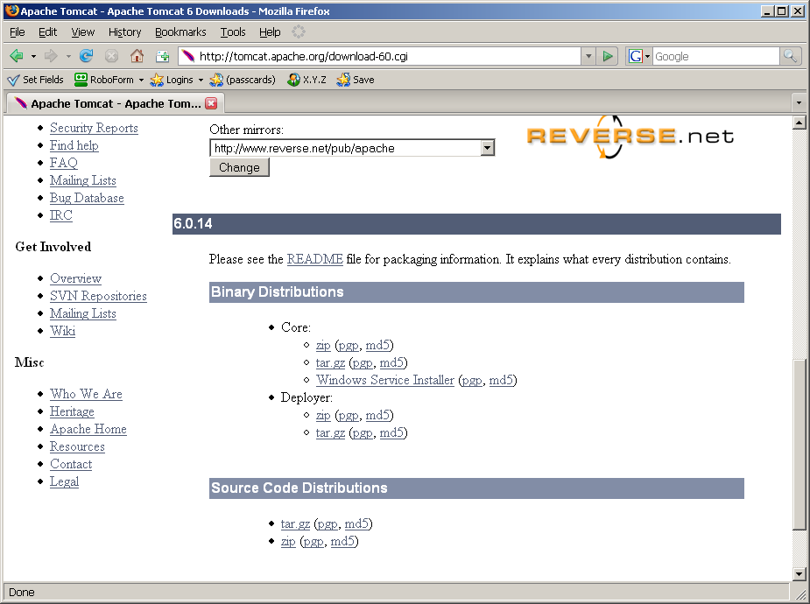
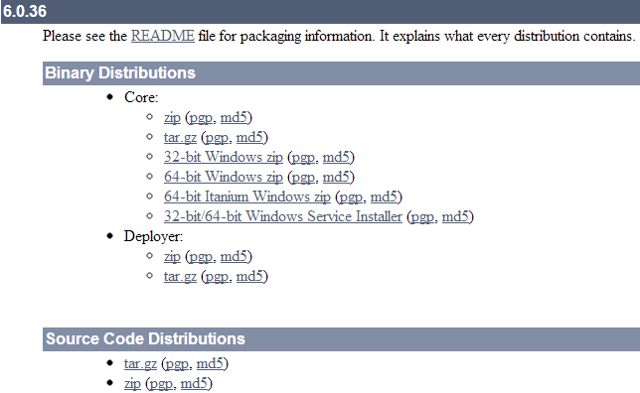
Download: http://tomcat.apache.org/download-60.cgi
Setup Wizard

Slide 48
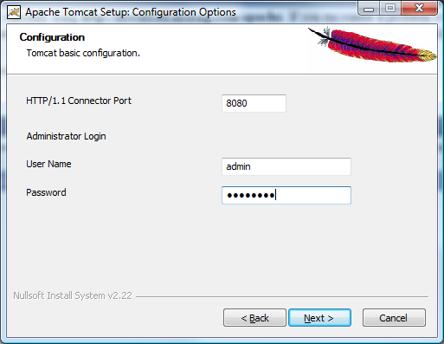
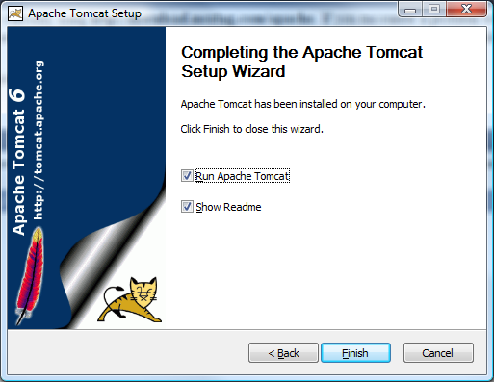
Installation / Setup Wizard

Slide 49
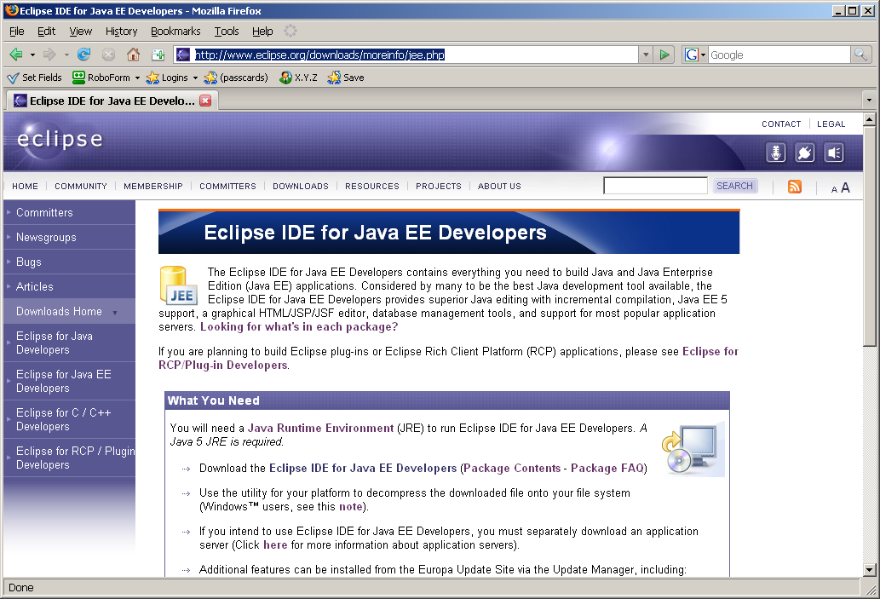
Stepe 2: Download Eclipse IDE for Java EE
http://www.eclipse.org/downloads/moreinfo/jee.php

Slide 50
Step 3: Configure Tomcat and Eclipse
The following tutorial shows how can you configure Tomcat and Eclipse:
http://www.eclipse.org/webtools/jst/components/ws/1.5/tutorials/InstallTomcat/InstallTomcat.html

Slide 51
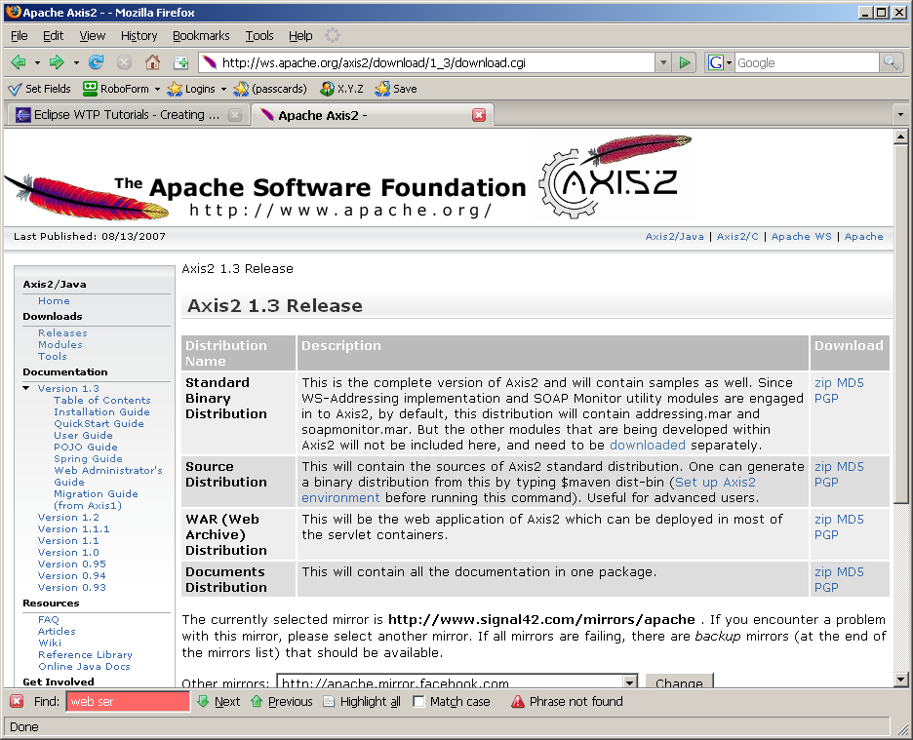
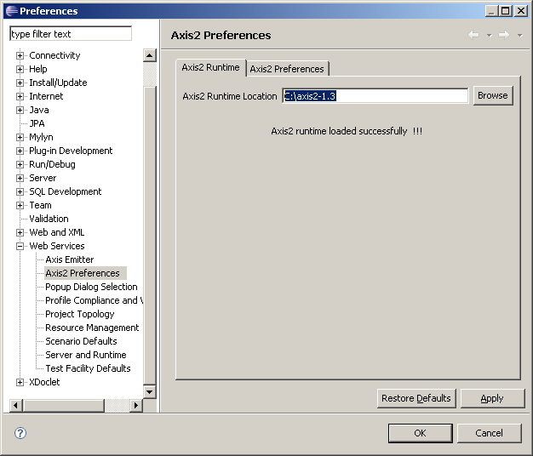
Step 4: Download and Configure Axis2
Download Axis2 from http://ws.apache.org/axis2/download.cgi
Unzip the downloaded file and run:

Slide 52
Step 4: Download and Configure Axis2
In Eclipse, choose window->preferences->web services->axis2 preferences, specify the axis2 location as the following diagram shows.

Slide 53
Creating a Complete SOC Application Using Eclipse, Axis2, and Tomcat
http://www.eclipse.org/webtools/community/tutorials/BottomUpAxis2WebService/bu_tutorial.html
Create a Web service in Java using Eclipse and Axis2
Hosting the Web service in Tomcat and publishing the Web service in UDDI
Create an application (client) that uses existing services

Slide 54
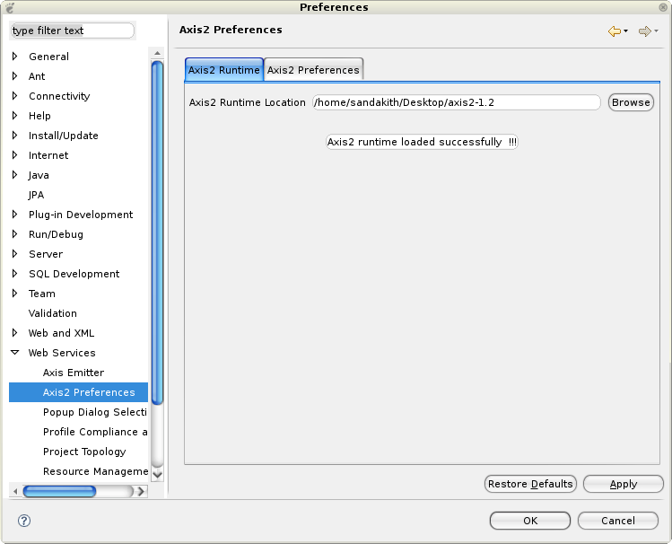
In Eclipse WTP: Open Window -> Preferences -> Web Services -> Axis2 Emitter

Slide 55
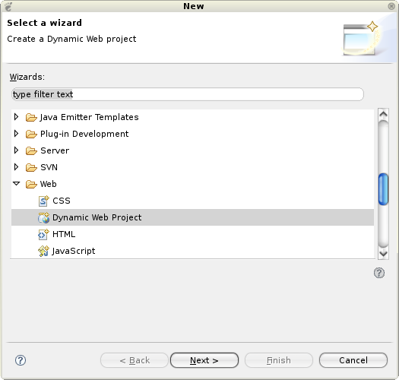
Open File -> New -> Other... -> Web -> Dynamic Web Project

Slide 56
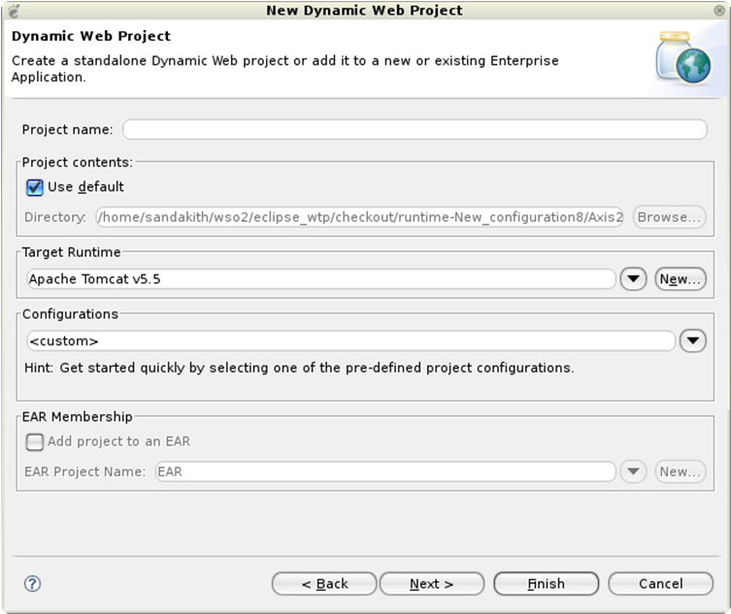
Select the configured Tomcat runtime as the target runtime
myFirstAxisProject

Slide 57
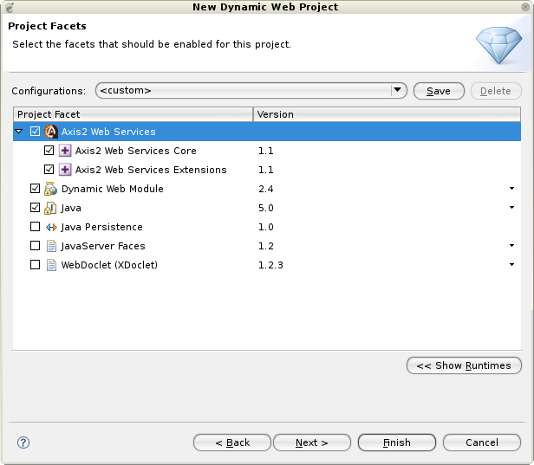
Select the Axis2 Web service facet

Slide 58
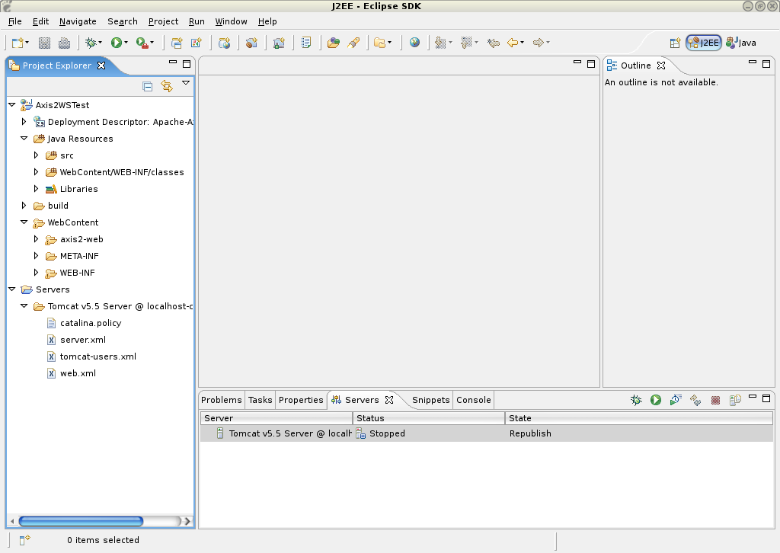
A dynamic Web Service Project is Created

Slide 59
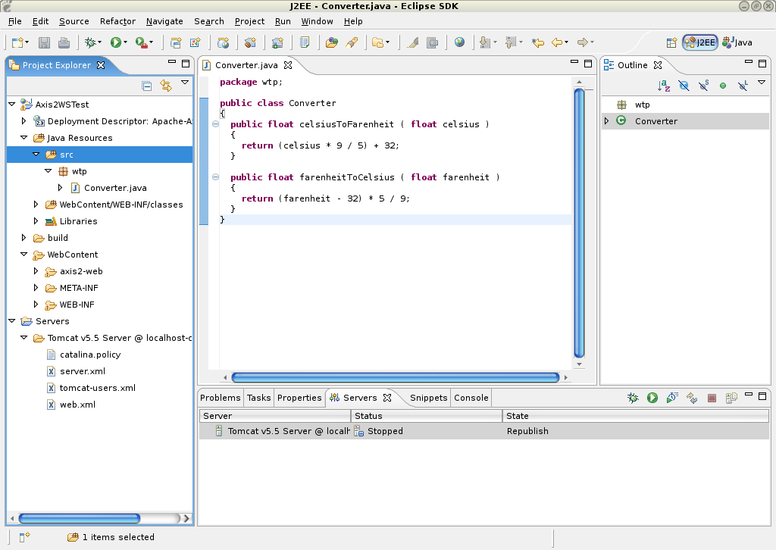
Type your Java code here

Slide 60
Creating a Complete SOC Application Using Eclipse, Axis2, and Tomcat
http://www.eclipse.org/webtools/community/tutorials/BottomUpAxis2WebService/bu_tutorial.html
Create a Web service in Java using Eclipse and Axis2
Hosting the Web service in Tomcat and publishing the Web service in UDDI
Create an application (client) that uses existing services

Slide 61
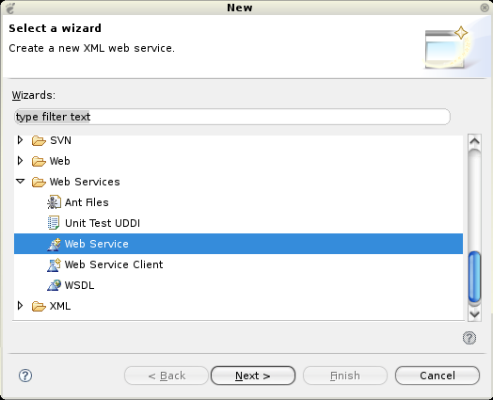
Open a WS: File -> New -> Other... -> Web Services -> Web Service

Slide 62
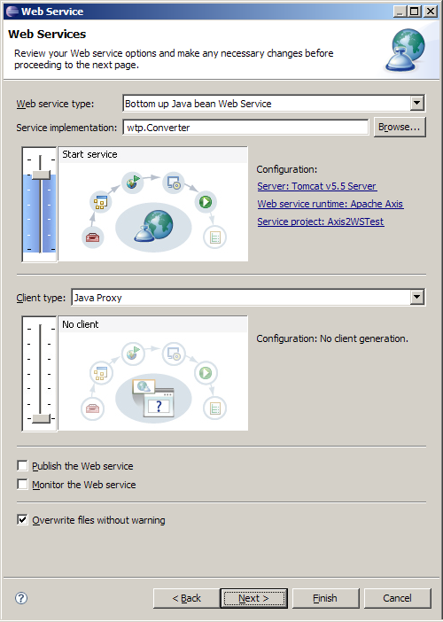
Move the service scale to Start service

Slide 63
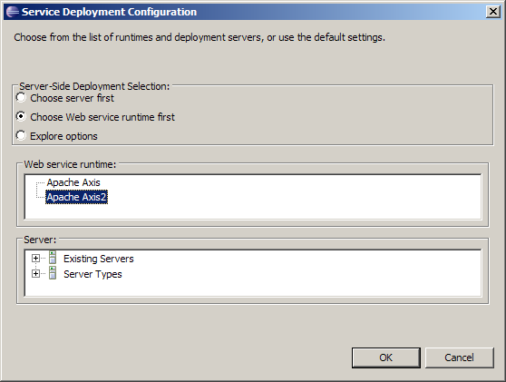
Click on the Web Service runtime link to select the Axis2 runtime

Slide 64
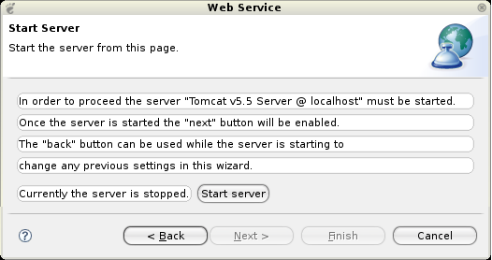
Click on the Start Server button. This will start the server runtime
The Tomcat server will be started

Slide 65
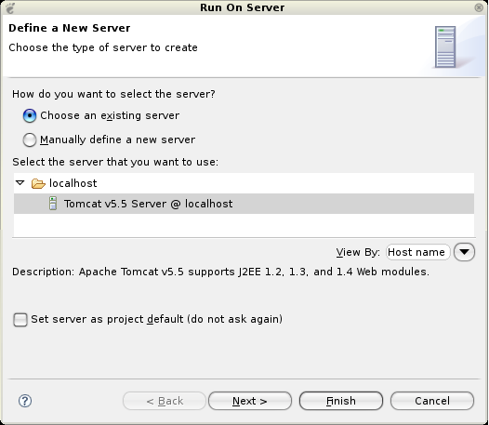
Hosting the Service in Tomcat: Select Run -> Run As -> Run on Server

Slide 66
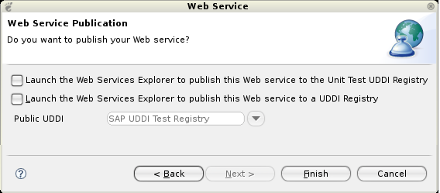
Publish the Service in an UDDI Registry

Slide 67
Creating a Complete SOC Application Using Eclipse, Axis2, and Tomcat
http://www.eclipse.org/webtools/community/tutorials/BottomUpAxis2WebService/bu_tutorial.html
Create a Web service in Java using Eclipse and Axis2
Hosting the Web service in Tomcat and publishing the Web service in UDDI
Create an application (client) that uses existing services

Slide 68
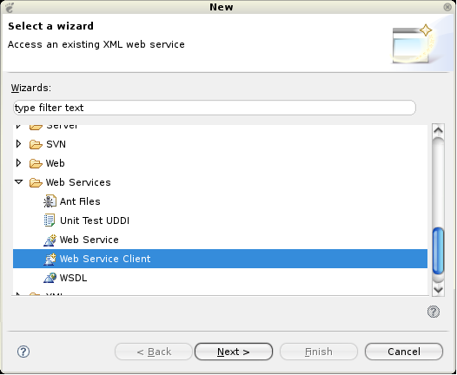
Open File -> New -> Other... -> Web Services -> Web Service Client

Slide 69
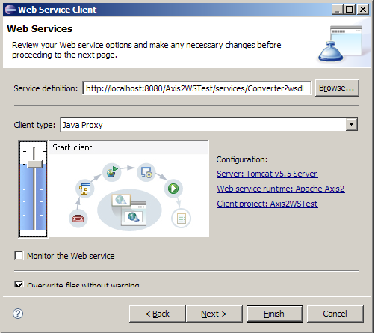
Add Service Reference: Paste the URL that was copied earlier into the service definition field
URL

Slide 70
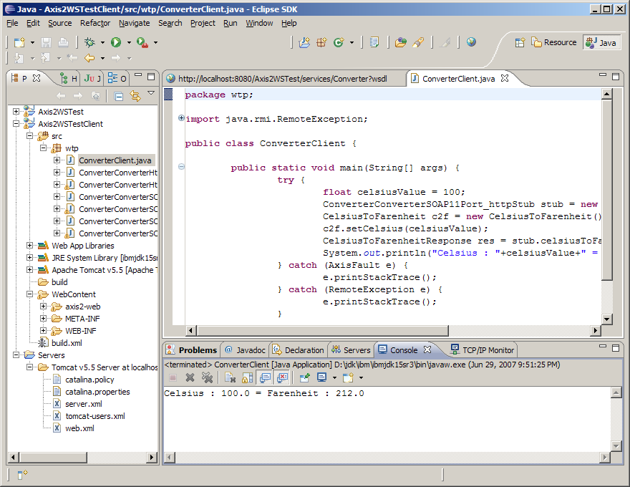
Proxy to the Web service

Slide 71
SUMMARY
Overview of SOC Development Environments
Service provision and hosting: Use ASP .Net to develop C# based Web Services and host them IIS.
Service broker: UDDI Data Models / Data Structures
Service requester: Use ASP .Net to develop Web services-based applications
.Net Remoting
AJAX Dynamic Web Programming
Java-Based Web services and Web Application Development Environments
As service provider
As service requester

